Slide 1
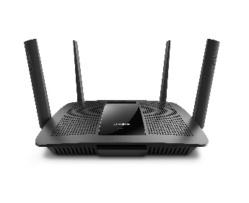

SSH Server
Port 22
Port 123 → 22
myhouse:123

Slide 2

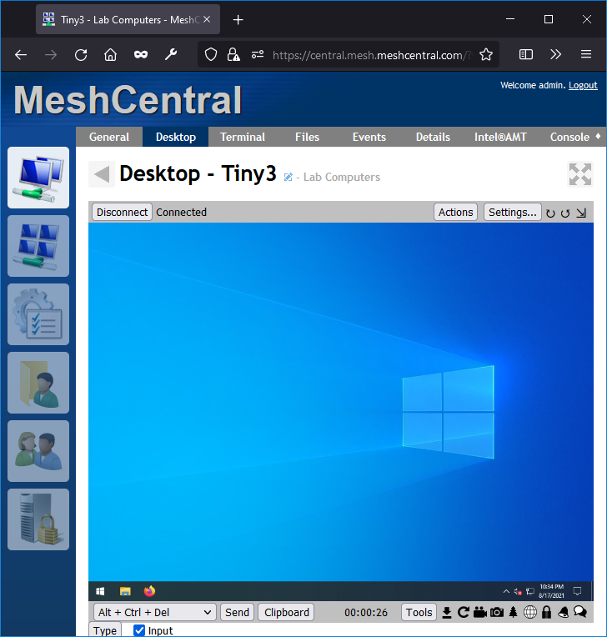
MeshCentral
Port 80
Port 443
Port 4433
Port 123 → 443
myhouse:123

Slide 3
Mesh Agent
MeshCentral
myhouse:443
X
Port 80
Port 443
Port 4433
Port 123 → 443

Slide 4
Mesh Agent
MeshCentral
myhouse:123
Port 80
Port 443, Alias 123
Port 4433
Port 123 → 443

